Slide 1
Big Data Group Assignment
Group Members
Jeet Shukla
Abhiroop Singh
Mrinal Singh Rana

Slide 2
Big data solutions for accidents/collisions
Accidents are serious issues, which can possibly cause disabilities, injuries and even fatalities.
In order to decrease the number of accidents, we need to understand and analyze the accidents dataset
Hadoop has the ability to store, manipulate, analyze, and mine large traffic accident datasets and can drive knowledge creation that can help decision makers to reduce the number of accidents.

Slide 3
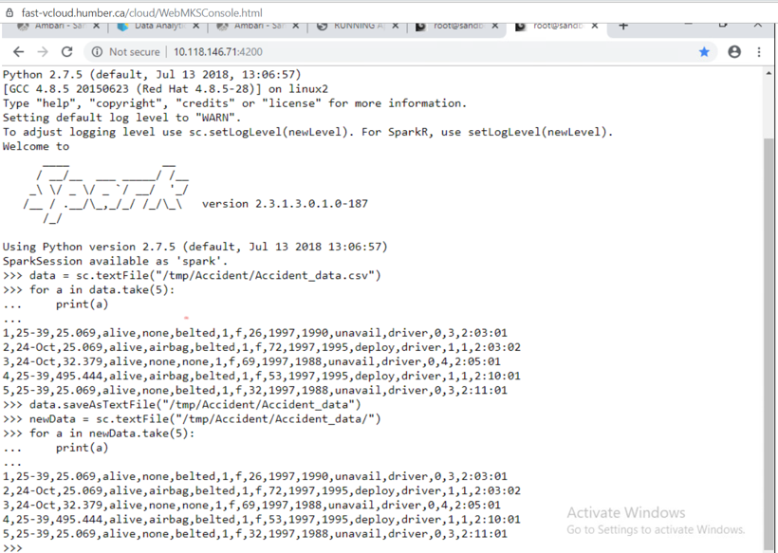
Reading data and saving it using SPARK

Slide 4
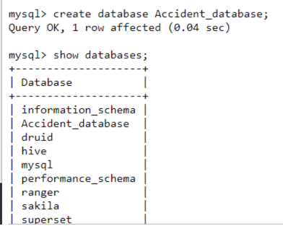
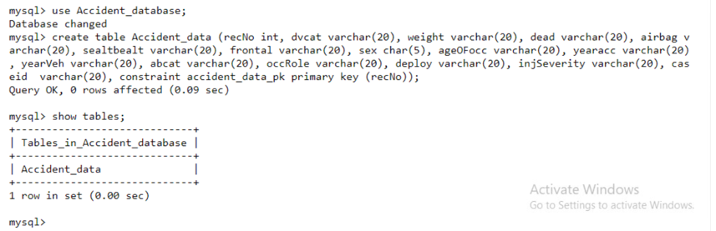
Creating DB and table in MySQL
Database
Table

Slide 5
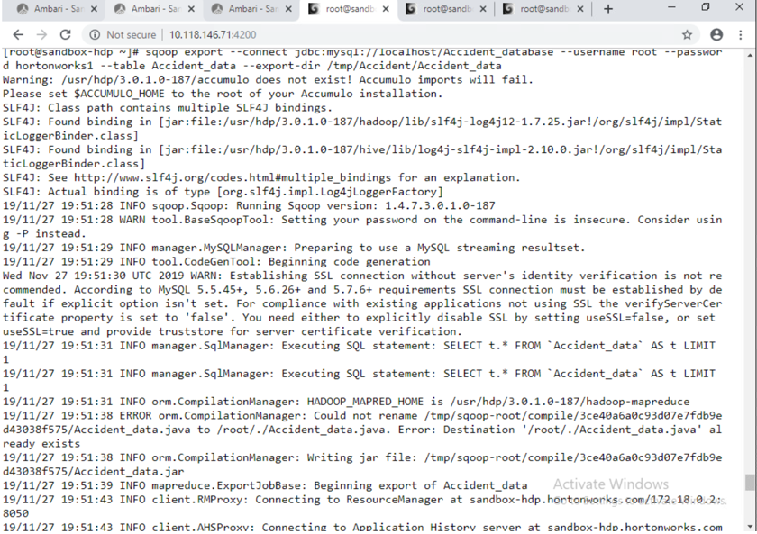
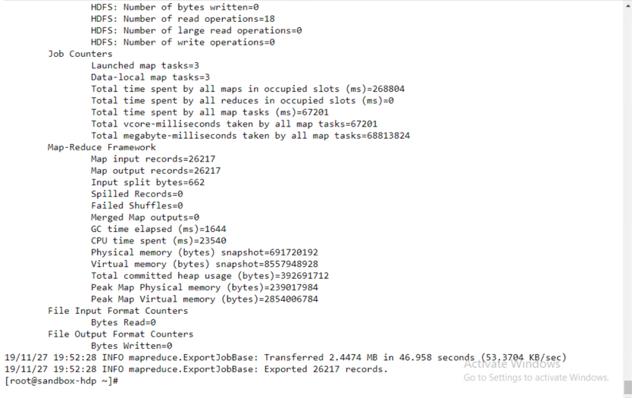
Exporting data into MySQL

Slide 6
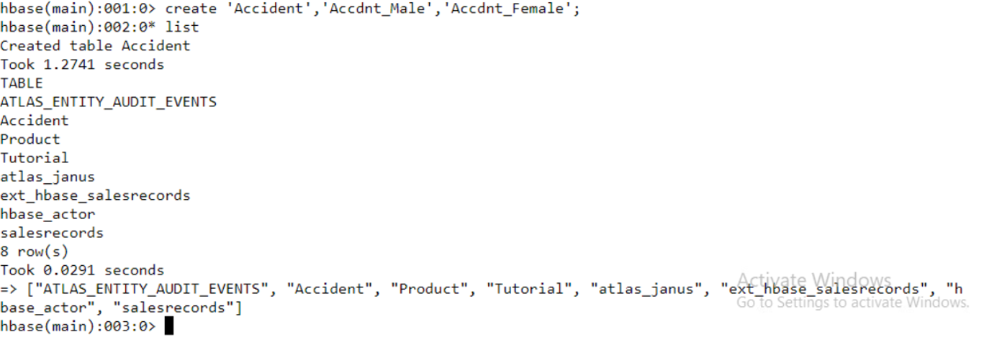
Creating Hbase table

Slide 7
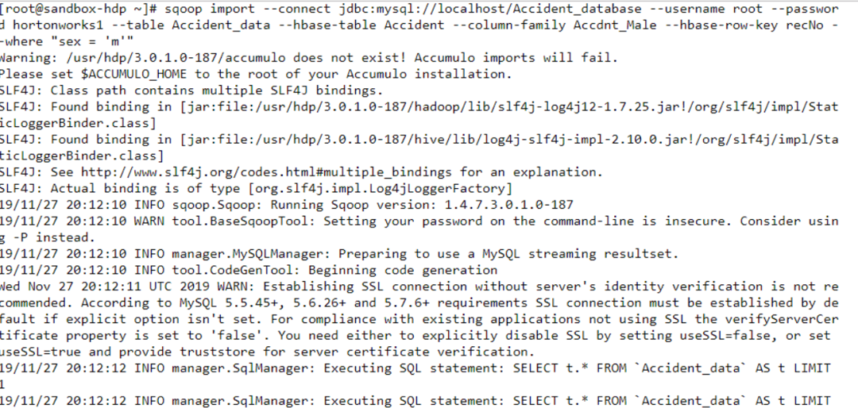
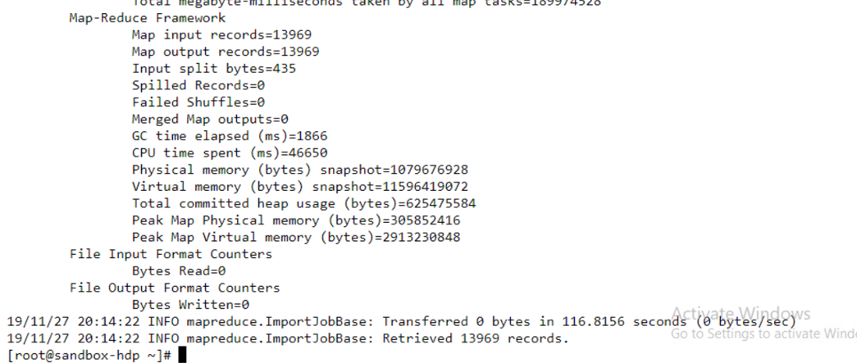

Slide 8
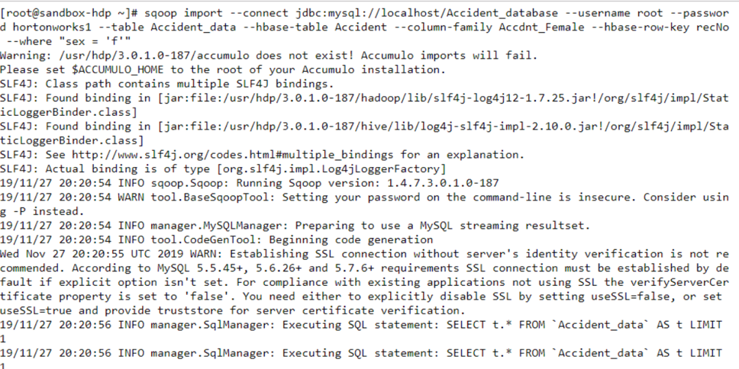
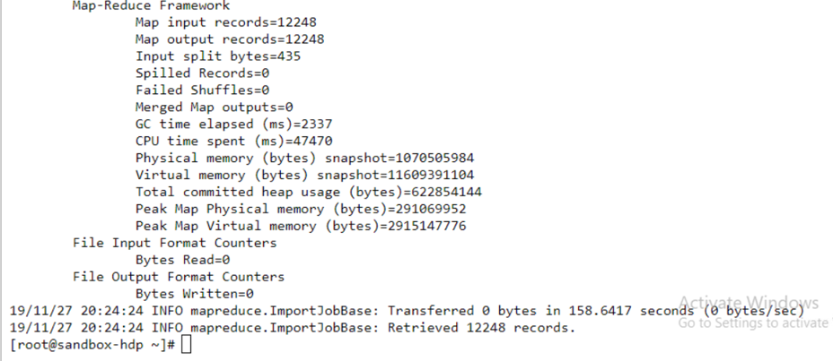

Slide 9
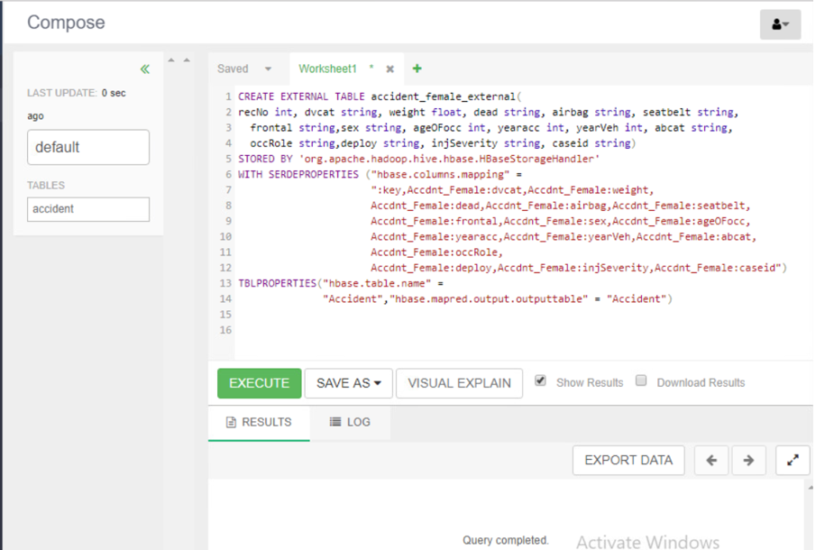
Mapping Hive with HBase

Slide 10
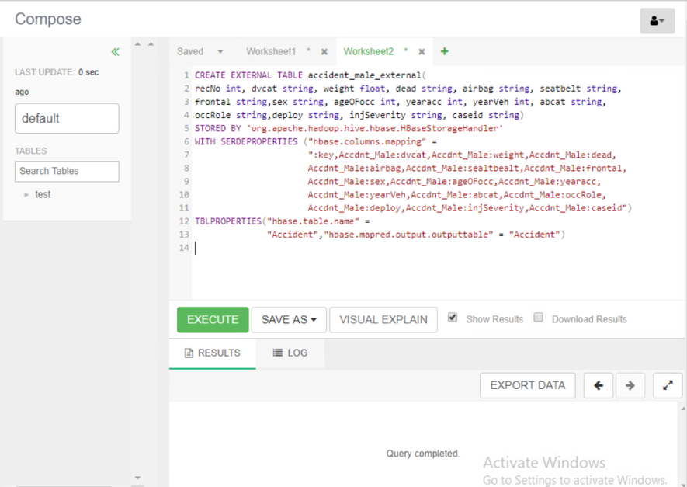
Mapping Hive with HBase

Slide 11
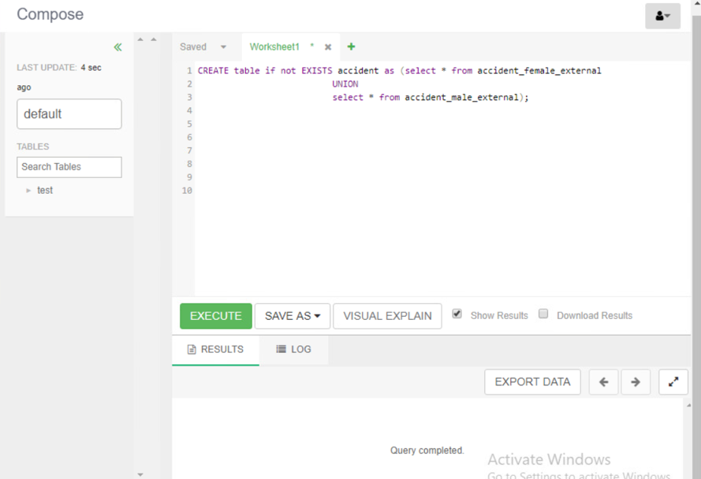
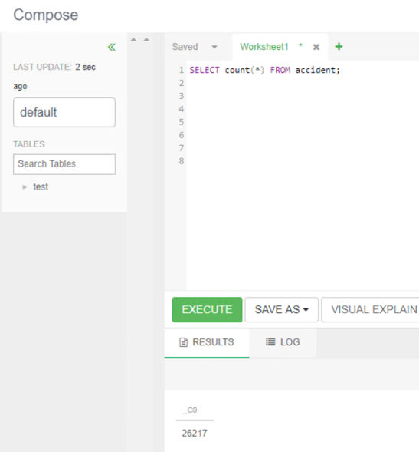
Creating Internal Hive table

Slide 12
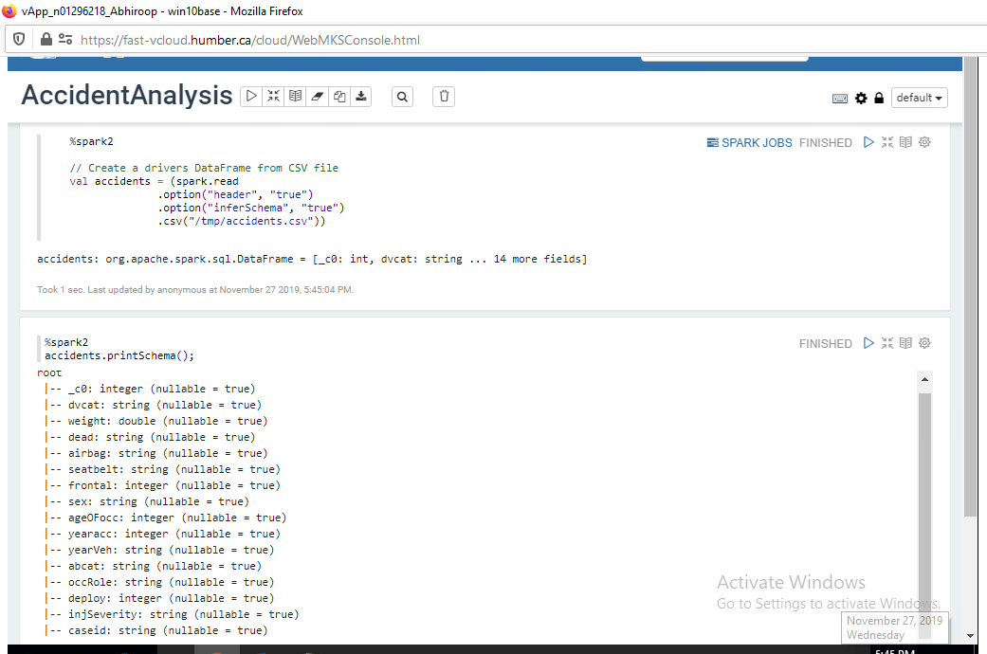
DataFrame for Analysis

Slide 13
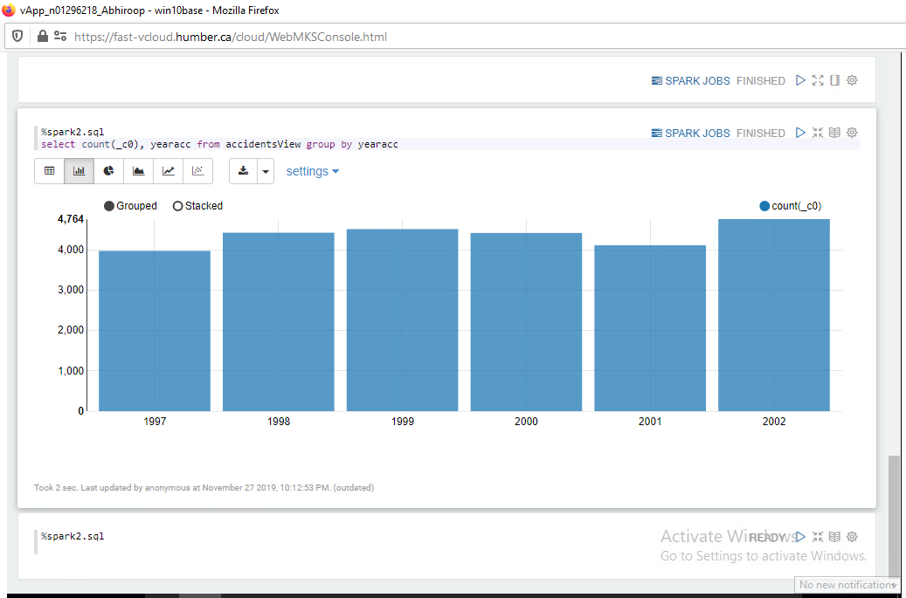
Zeppelin Graphs
Number of accidents by year

Slide 14
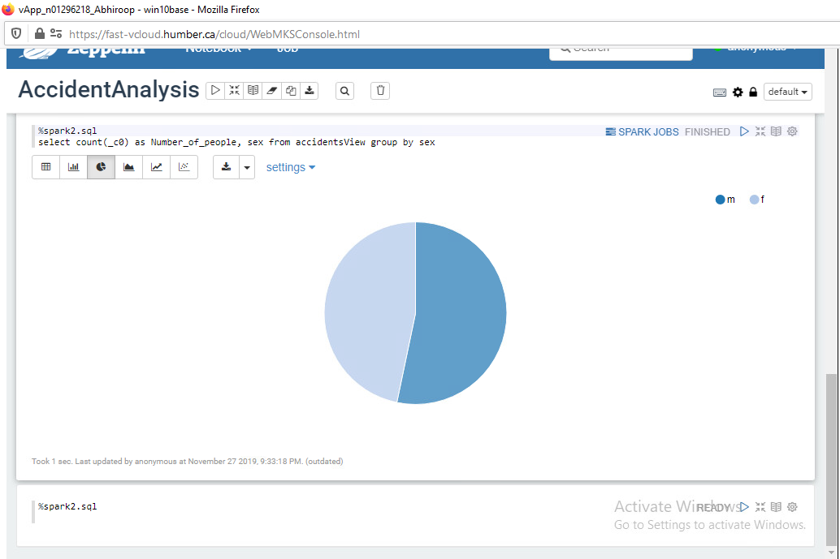
Reports in Zeppelin
Ratio of male and female involved in an accident

Slide 15
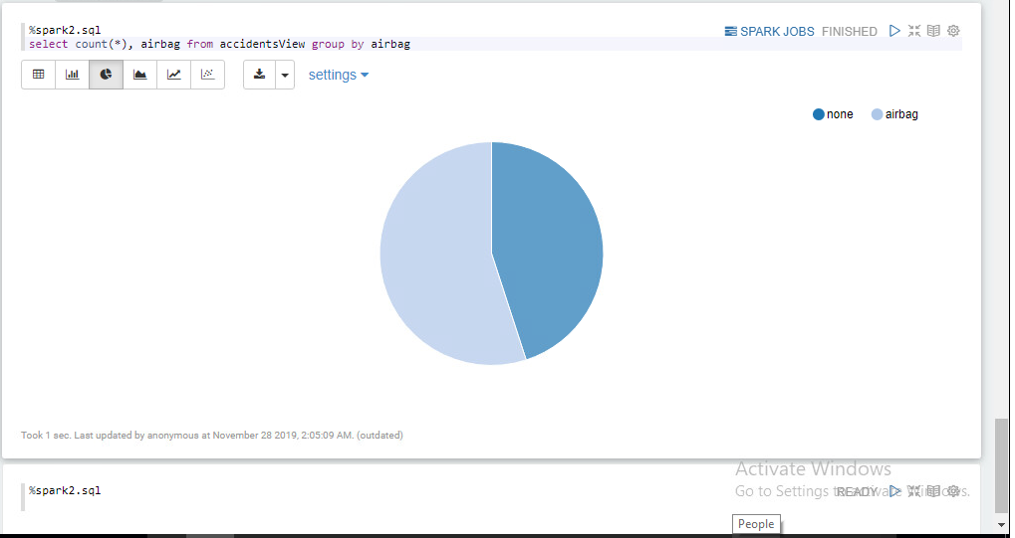
Zeppelin reports
Share of cars with and without Airbags

Slide 16
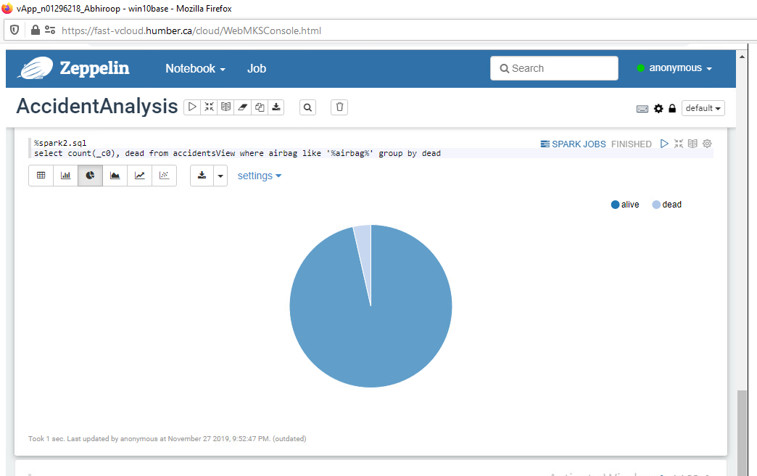
Zeppelin graphs
Number of people alive and dead with Airbag

Slide 17
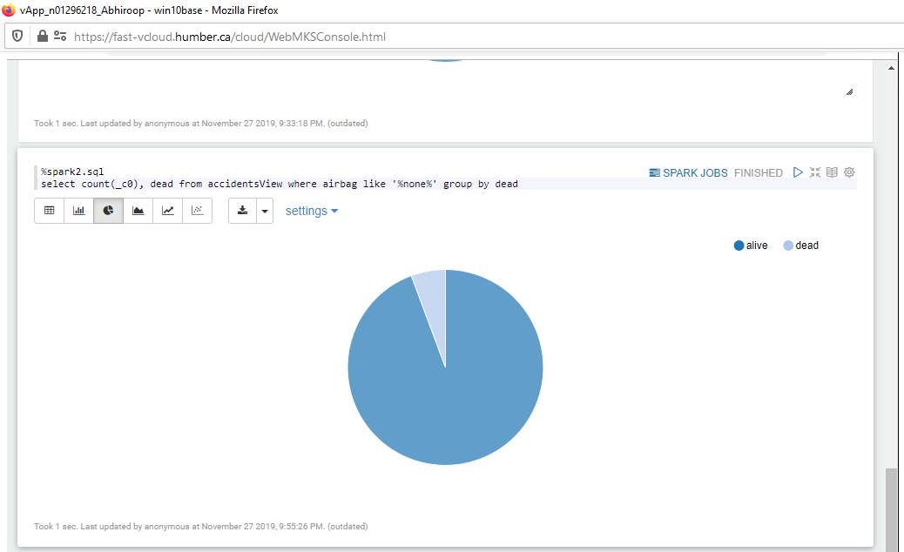
Zeppelin graphs
Number of people alive and dead with NO Airbag

Slide 18
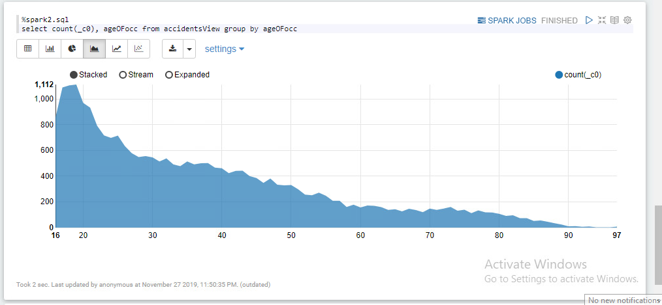
Accidents by age

Slide 19
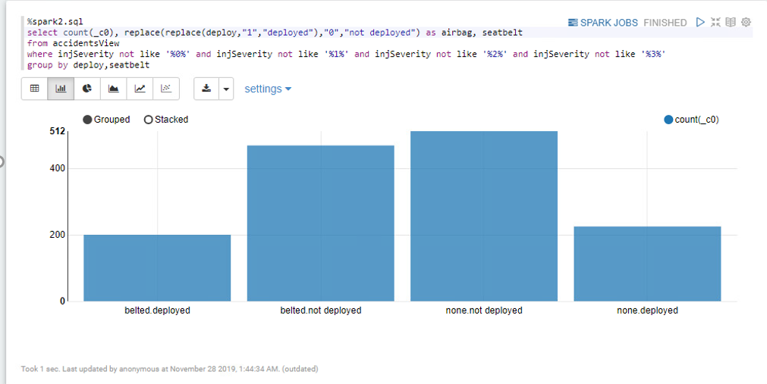
Severe injuries by categories

Slide 20
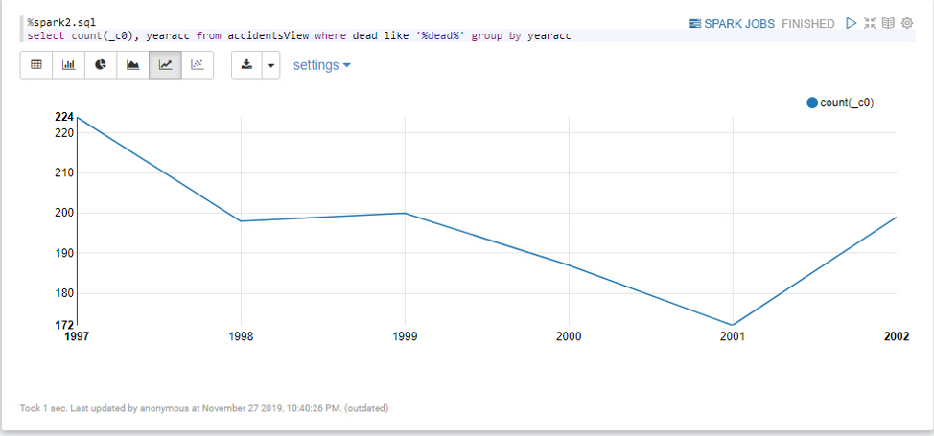
Accidents related deaths per year

Slide 21
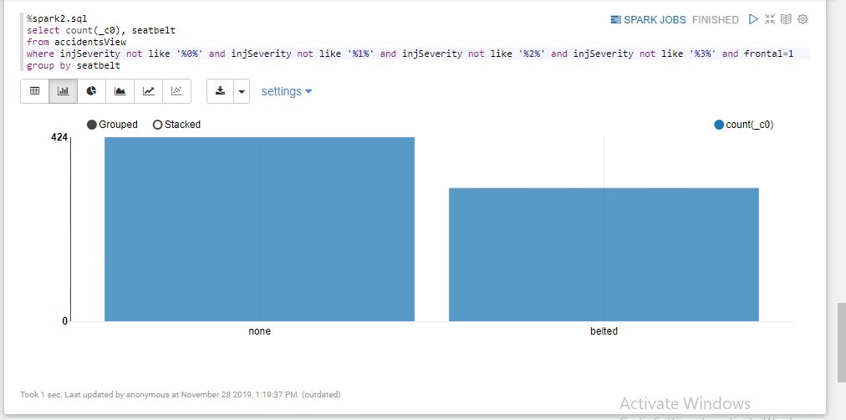
Seatbelt related injuries

Slide 22
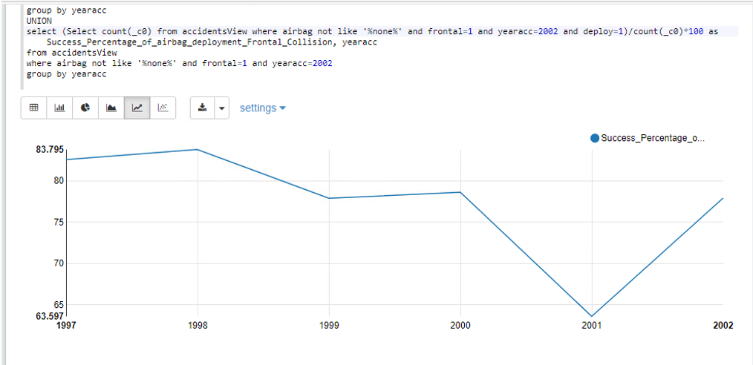
Deployment success ratio of Airbags

Slide 23
Analysis
Number of deaths without Airbags are more than the one with Airbags
Though share of cars for no Airbags is less, the deaths/accidents are more.
Number of accidents growing by every year

Slide 24
Thank you!
Any Questions?

